Slide 1

UWP (… or mostly XAML...)
Einar Ingebrigtsen
Technical Evangelist, DX

Slide 2
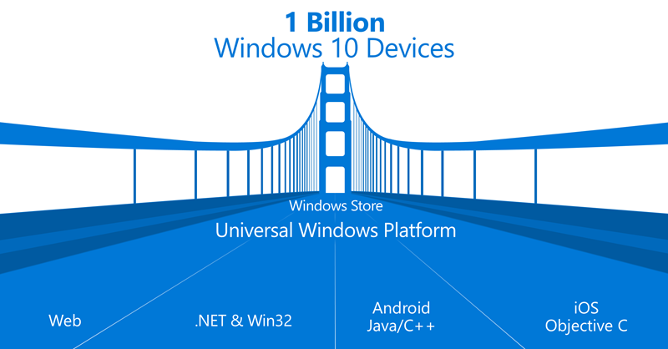

Slide 3
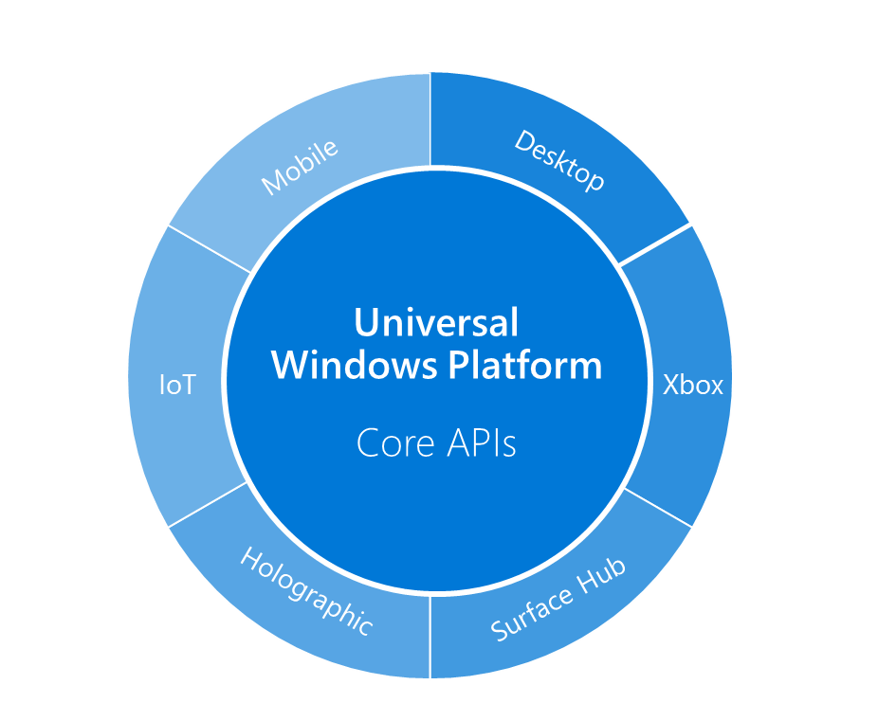
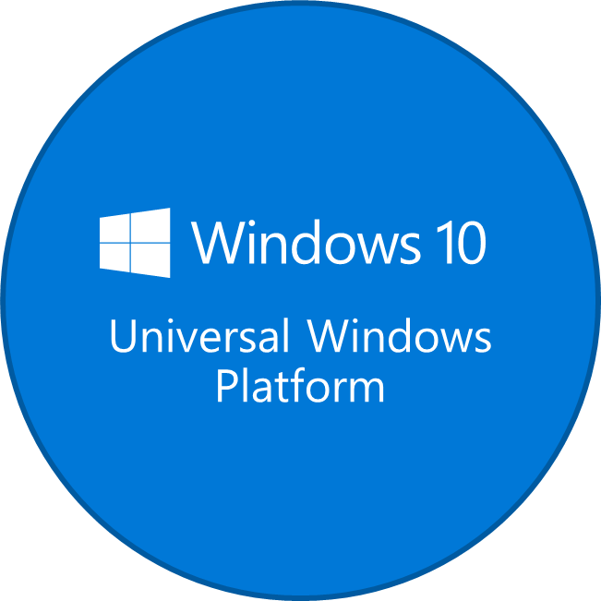
Bring your code to Windows Wherever your code was born, you can bring it to Windows
New opportunities
Over 1 billion Windows 10 devices *
Expand to reach PC, mobile, and consoles
Emerging form-factors (IoT, Holographic)
Reach Windows 10 fast
UWP Bridges accelerate time to Windows
Support for most middleware + game engines
Go native at your pace
‘Light up’ Windows differentiators
Get more reuse out of your core code
Windows platform
Universal Windows 8 apps
Universal Windows 10 apps
Classic applications (via ‘Centennial’)
Web platform
Web apps
Hybrid web apps (Cordova tooling)
Hosted web apps (via ‘Westminster’)
Middleware platforms
Middleware (e.g., Xamarin)
Game engines (e.g., Unity)
Other mobile platforms
Android apps (via ‘Astoria’)
iOS apps (via ‘Islandwood’)
* http://blogs.windows.com/buildingapps/2015/04/29/expanding-the-universal-windows-platform-at-build-2015/

Slide 4
XAML
Based on WPF (Windows Presentation Foundation)
Layout is by default not flowing – unlike HTML
Active view
Observing capabilities
Declarative binding
Declarative hookup of actions

Slide 5
Dependency Object
Base type for all elements that can sits inside XAML
Can hold dependency properties…

Slide 6
Dependency Property
Capable of binding to properties
Properties are registered on a DependencyObject
Callback when property changes
Sits as part of a property bag on a DepdencyObject

Slide 7
Attached Dependency Property
Same as Dependency Property
… except for; it can be attached to any object – “extending types”
Examples
Validation
Augmenting with new functionality making it declaratively available – maintaining concerns

Slide 8
Routed Events
Bubbles up the hierarchy (VisualTree)
Holds information about the original source
Examples: Focus, LostFocus

Slide 9
ContentControl
Base class for all controls that has content
Can only have one element as content
Examples: TextBlock, Button

Slide 10
ItemsControl
Base class for controls that has items
Items can be templated; DataTemplate
Items can be provided through Binding
ItemsPanelTemplate defines the panel wrapping the items
Examples: ListBox, ComboBox

Slide 11
Resources
ALL UIElements can have resources available for their scope
Application level resources (App.xaml)
Hierarchical
A resource can be anything, even a CLR object
Most often used for Styling and templating and storing of reusable objects

Slide 12
Resource Dictionaries
Resources are represented as Key/Value in a dictionary
MergedResourceDictionary gives you the ability to include dictionaries from other files

Slide 13
Styling
Styles can change any property, not only visual properties. Anything exposed on any object
Must specify target type
Implicit Styling
No key just a target type
Inheritance - BasedOn

Slide 14
Control Templating
You can alter the entire look and feel
Can be set directly on a control when used or as a style – even implicitly for all instances of the target type

Slide 15
Visual States

Slide 16
Layout
Grid
StackPanel
RelativePanel
Viewbox

Slide 17
User Controls
XAML + Code Behind
Useful for breaking up the monolith into composable pieces

Slide 18
DataContext
All FrameworkElements has a DataContext
Hierarchical
Children inherits DataContext from parent unless explicitly set

Slide 19
Binding
Markup extension - {Binding …}
Can specify source unless you want it to be relative to the DataContext
Path property specifies the property path relative to the source
Mode
OneWay (default), TwoWay, OneTime
ValueConverter
FallbackValue
TargetNullValue
Can use another element as source (ElementName)

Slide 20
Active View
INotifyPropertyChanged
INotifyCollectionChanged
Concrete implementation: ObservableCollection<>
New: IObservableMap<> and IObservableVector<>

Slide 21
MVVM

Slide 22
MVVM
Behavior
Business logic relevant to the frontend without knowing about the view
Can be connected to the server or 3rd party dependencies outside the realm of the view+viewModel
Represented as commands (by default)
State
Model
App logic state

Slide 23
MVVM WHY
Separate the concerns – make things clearer
View is great at view concerns
ViewModel is great at holding state and exposing behaviors
Promotes cleaner code
Testable
Perfect match for XAML based platforms

Slide 24
Event Aggregator

Slide 25
Triggers / Actions (when I push the door-handle, the door opens)
Declaratively defined in the View
Somethings Triggers
Performs an action
A package dependency away (Microsoft.Xaml.Behaviors.Uwp.Managed)

Slide 26
Behaviors
Simple explanation: Multiple Triggers, one end action
Example: Drag and drop

Slide 27
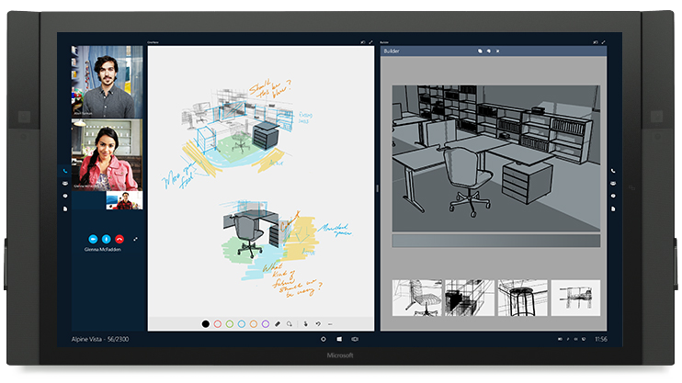
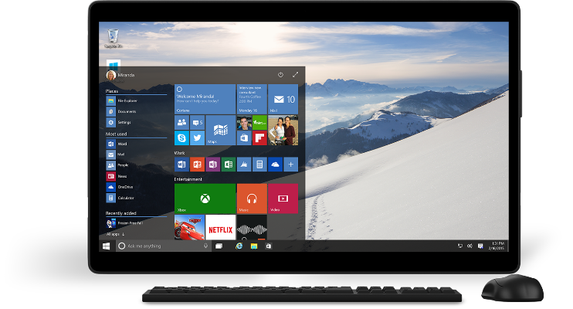
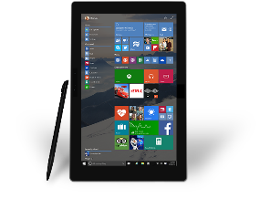
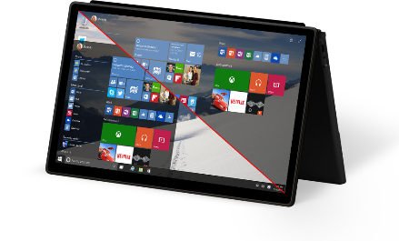
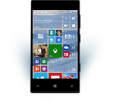
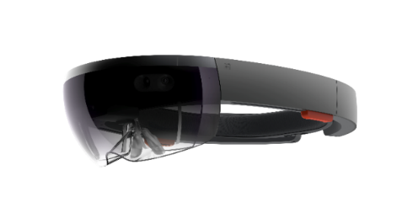
UWP in Windows 10
Windows 10 Goal: Increase reach and opportunity
UWP Goal: Reduce developer cost to deliver on the increased opportunity

Slide 28
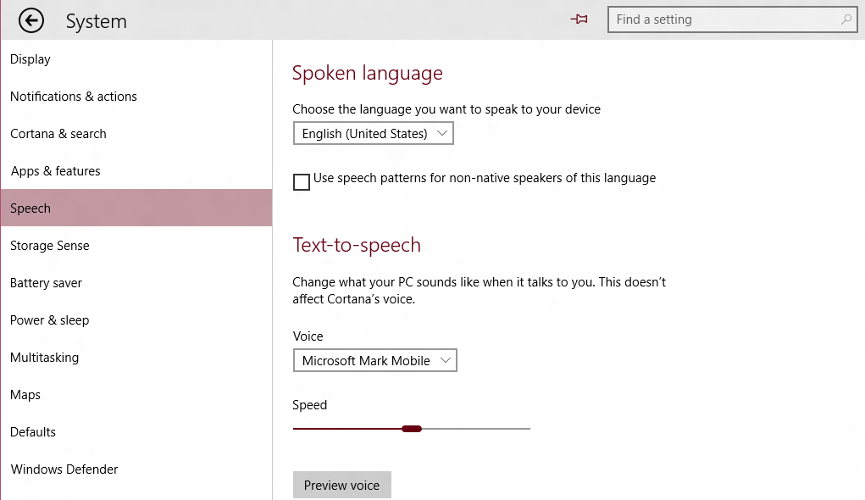
This Session: XAML UI
The “Native” UI Framework for Windows 10 Apps and Experiences
Supports C++ or C#/VB
<!-- XAML Outline -->
<Page>
<StackPanel Orientation="Horizontal">
<AppBarButton/>
<AutoSuggestBox/>
</StackPanel>
<Grid>
<ListView/>
<TextBlock Text="Spoken Language"/>
<ComboBox/>
<CheckBox/>
<Slider/>
<Button/>
</Grid>
</Page>

Slide 29

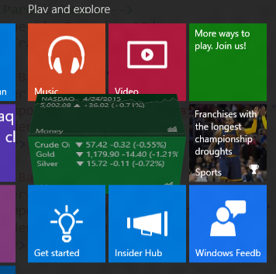
XAML in Windows 10: Beyond UW Apps New/enhanced controls, performance, much more…
We are listening…

Slide 30
Getting to Universal Windows Controls

Slide 31
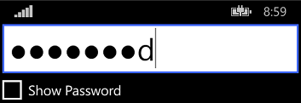

“Universal” Controls in 8.1 Some differences in look, feel and APIs
Windows 8.1 Desktop
Phone 8.1 (Blue)

Slide 32

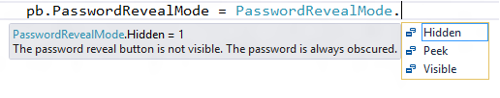
Upgrading to Windows 10 But, that also means some things had to change
IsPasswordRevealButtonEnabled in 8.1 (bool value)

Slide 33
Newly Universal Controls

Slide 34

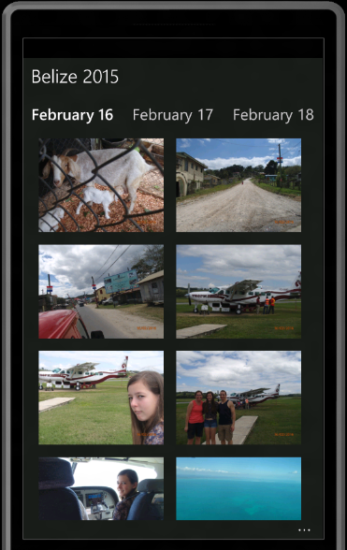
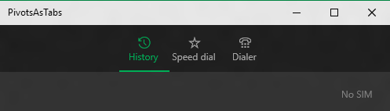
Newly Universal Controls: Pivot Great for 1-handed on Mobile, Tabs on desktop

Slide 35
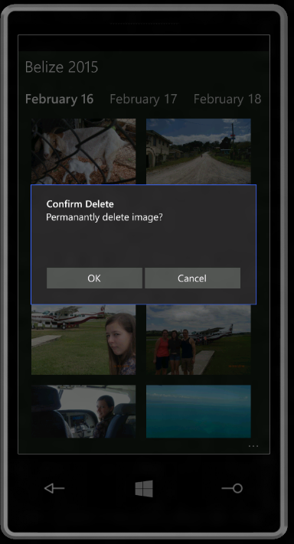
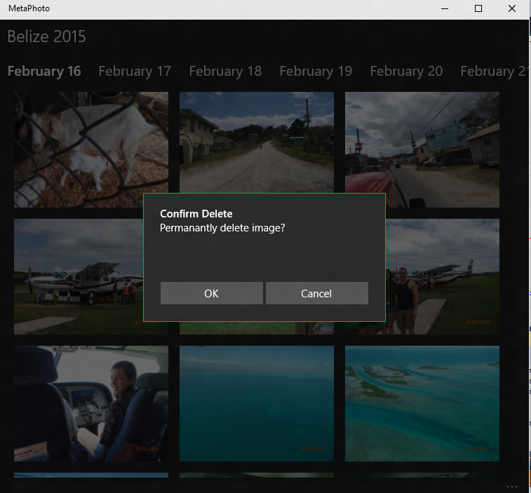
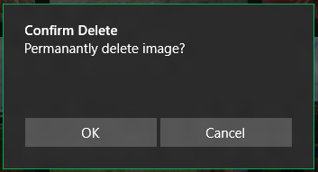
Newly Universal Controls: ContentDialog App model, XAML child content

Slide 36
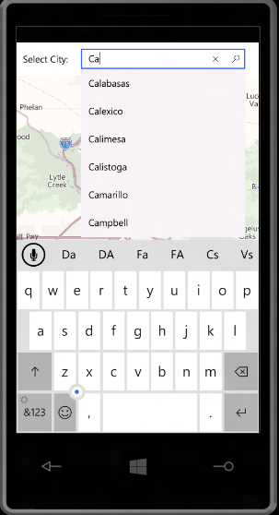
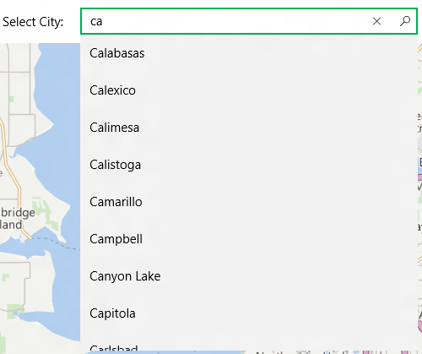
Newly Universal Controls: AutoSuggestBox And IME support, glyph

Slide 37
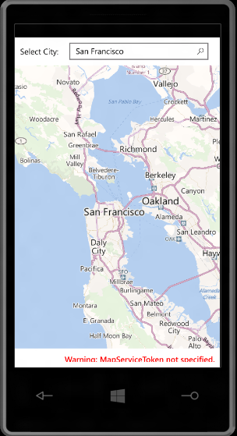
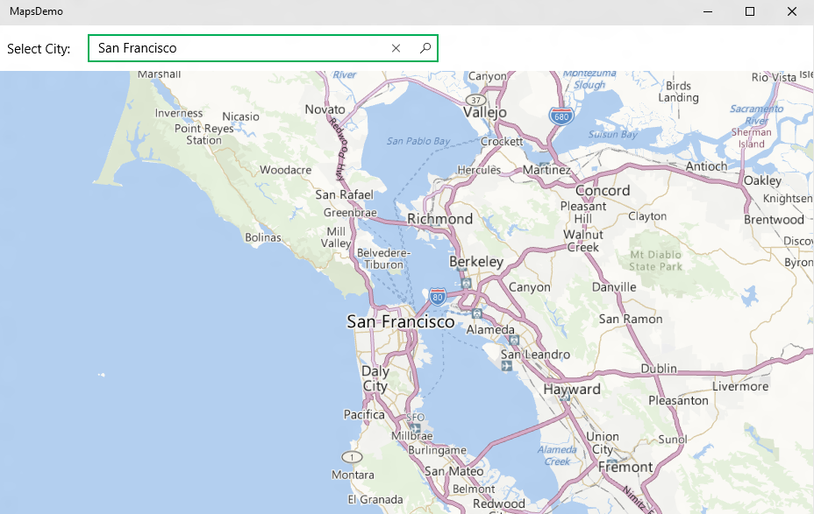
Newly Universal Controls: Maps Plus Offline, 3D, Street Side Panoramas

Slide 38
Using XAML to Build UW Apps It’s more than just universal controls

Slide 39
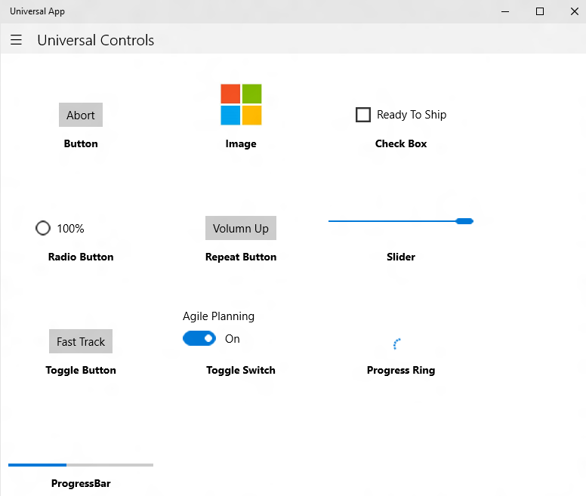


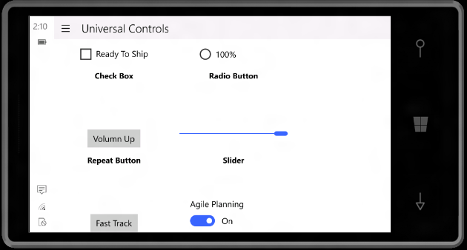

Common Controls Common Branding, Behavior, Scaling, Support Diverse Inputs

Slide 40
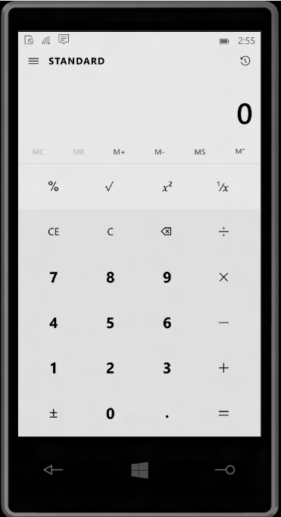
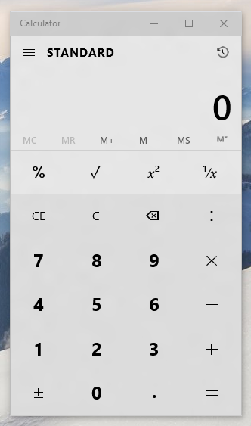
Controls Reusable Across Devices/Displays Views may be reusable (but likely to need tailoring)

Slide 41
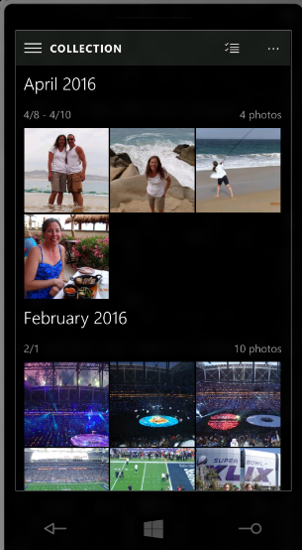
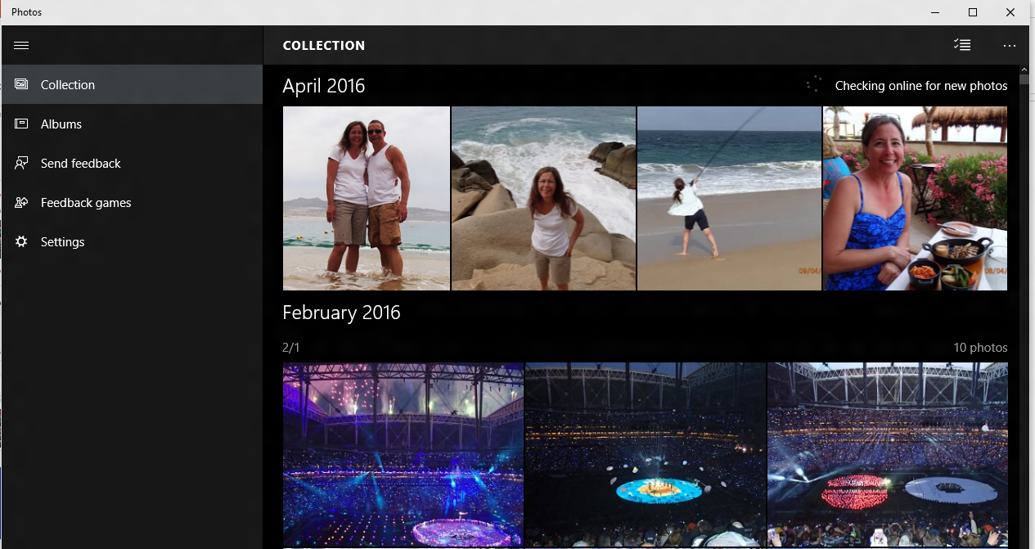
Tailoring App Experiences Typically via responsive pages or multiple views
Windows 10 has new features to help with responsive designs

Slide 42
New XAML Features for Building Responsive UW Apps

Slide 43
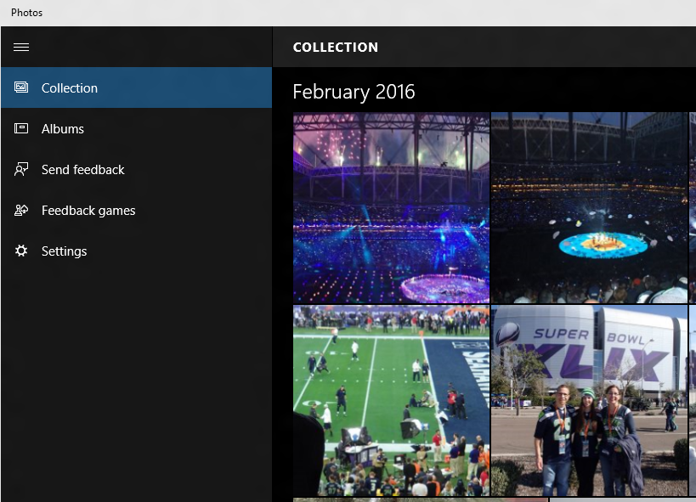
SplitView Adaptive navigation pane
<SplitView DisplayMode="Inline|Overlay|CompactInline|CompactOverlay">
<SplitView.Pane>
<!-- Navigation Content Here -->
</SplitView.Pane>
<!-- Main Content Here -->
</SplitView>

Slide 44
Simplifying Responsive View Development Triggers and Setters (XAML equivalent of Media Queries)
<VisualState.Setters>
<Setter Target="splitView.DisplayMode" Value="Inline" />
</VisualState.Setters>
<VisualState.StateTriggers>
<AdaptiveTrigger MinWindowWidth="720" />
</VisualState.StateTriggers>
<VisualState.Setters>
<Setter Target="splitView.DisplayMode" Value="Overlay" />
</VisualState.Setters>
<VisualState.StateTriggers>
<AdaptiveTrigger MinWindowWidth= "0" />
</VisualState.StateTriggers>
If the Window width is >= 720 effective pixels, then show SplitView in Inline mode

Slide 45


RelativePanel Enables elements to layout relative to other elements
<Grid>
<Grid.ColumnDefinitions>
<ColumnDefinition Width="Auto"/>
<ColumnDefinition Width="*"/>
</Grid.ColumnDefinitions>
<Image x:Name="img" …/>
<StackPanel Grid.Column="1" …>
<TextBlock x:Name="title" …/>
<TextBlock x:Name="authors" …/>
<TextBlock x:Name="summary" …/>
<Button Content="Download" …/>
</StackPanel>
</Grid>
“Traditional” nested panel layout can be challenging for more complex layouts

Slide 46
RelativePanel
<RelativePanel>
<Image x:Name="img" …/>
<TextBlock x:Name="title" RelativePanel.RightOf="img" RP.AlignTopWith="img" …/>
<TextBlock x:Name="authors" RP.RightOf="img" RP.Below="title" …/>
<TextBlock x:Name="summary" RP.RightOf="img" RP.Below="authors" …/>
<Button Content="Download" RP.RightOf="img" RP.AlignBottomWithPanel="True" …/>
</RelativePanel>
Use with Triggers and Setters for more advanced responsive designs
Note: RP above should be replaced with RelativePanel (shortened for readability)

Slide 47
XAML Performance in Windows 10

Slide 48
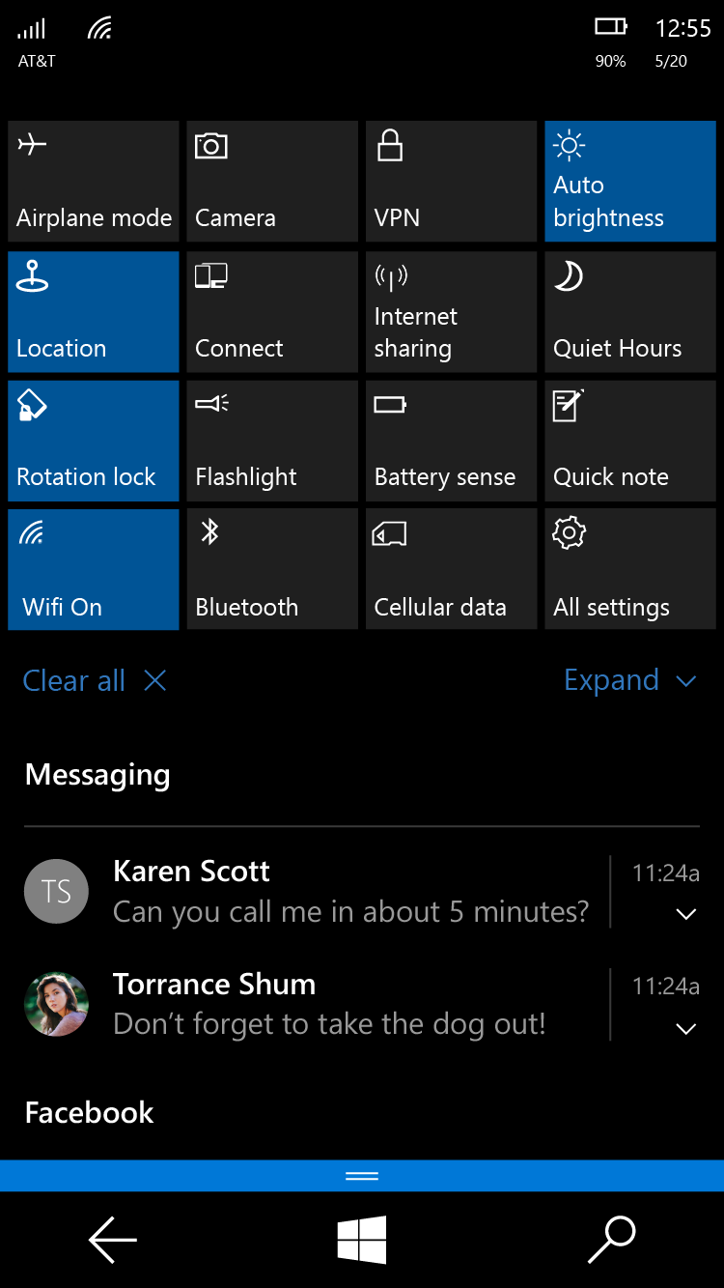
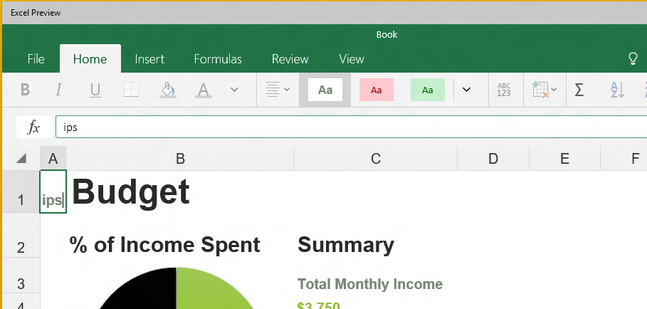
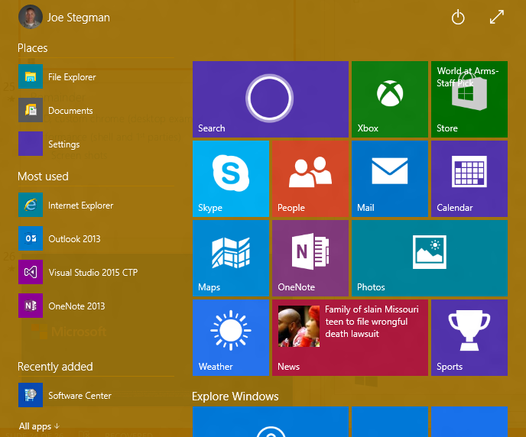
Validating XAML in Windows 10

Slide 49
Notable New Performance Features Compiled Bindings AKA {x:Bind}: Like {Binding}, only they go to 11
<ListView>
<ListView.ItemTemplate>
<DataTemplate>
<StackPanel>
<SymbolIcon Symbol="{Binding Symbol}"/>
<TextBlock Text="{Binding Name}"/>
<Button Click="Button_ClickHandler"/>
</StackPanel>
</DataTemplate>
</ListView.ItemTemplate>
</ListView>
<ListView>
<ListView.ItemTemplate>
<DataTemplate x:DataType="local:FreeBookCategory">
<StackPanel>
<SymbolIcon Symbol="{x:Bind Symbol}"/>
<TextBlock Text="{x:Bind Name}"/>
<Button Click="{x:Bind Click}"/>
</StackPanel>
</DataTemplate>
</ListView.ItemTemplate>
</ListView>
Resolved at compile time and produce compiler errors.

Slide 50
Other New UI Features

Slide 51
Change Notification on all Control Properties Technically, just the ones that are DependencyProperties
<!-- Get notifications when Button Content property changes -->
<Button x:Name="target" Content="{x:Bind Name}"/>
// Register for changes on “target.Current” property
target.RegisterPropertyChangedCallback(ContentControl.ContentProperty, ContentChanged);
// Handler
void ContentChanged(DependencyObject sender, DependencyProperty prop)
{
// Content Changed
Object content = (sender.GetValue(prop));
}

Slide 52
PerspectiveTransform3D Composable 3D Transforms (Effects: 3D Rotations, Parallax)
<Grid>
<Grid.Transform3D>
<!– Parent Camera -->
<PerspectiveTransform3D/>
</Grid.Transform3D>
<Border Background="#FF7F00">
<Border.Transform3D>
<CompositeTransform3D RotationX="-90 " …/>
</Border.Transform3D>
</Border>
<Border Background="#FF6700">
<Border.Transform3D>
<CompositeTransform3D RotationY="-90" …/>
</Border.Transform3D>
</Border>
</Grid>

Slide 53

Windowing Custom chrome, branding, sizing
<!-- XAML -->
<StackPanel x:Name="customTitleBar" Height="32" …>
<FontIcon …/>
<TextBlock Text="Belize 2015" …/>
</StackPanel>
// Remove Standard Title Bar
CoreApplication.GetCurrentView().TitleBar.ExtendViewIntoTitleBar = true;
// Indicate Custom App UI to use as the TitleBar (for move, resize)
Window.Current.SetTitleBar(customTitleBar);

Slide 54
Ink Canvas Palm rejection, smoothing, high fidelity
<Grid>
<!-- It’s this simple -->
<InkCanvas/>
</Grid>

Slide 55
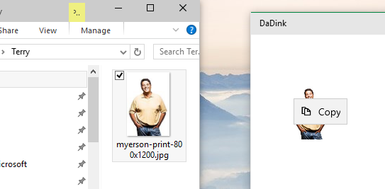
Drag and Drop Extended for “Windowed” Apps
<!-- XAML -->
<Grid AllowDrop="True" DragOver="Do_DragOver" Drop="Do_Drop" …>
…
</Grid>
File Explorer
My App

Slide 56
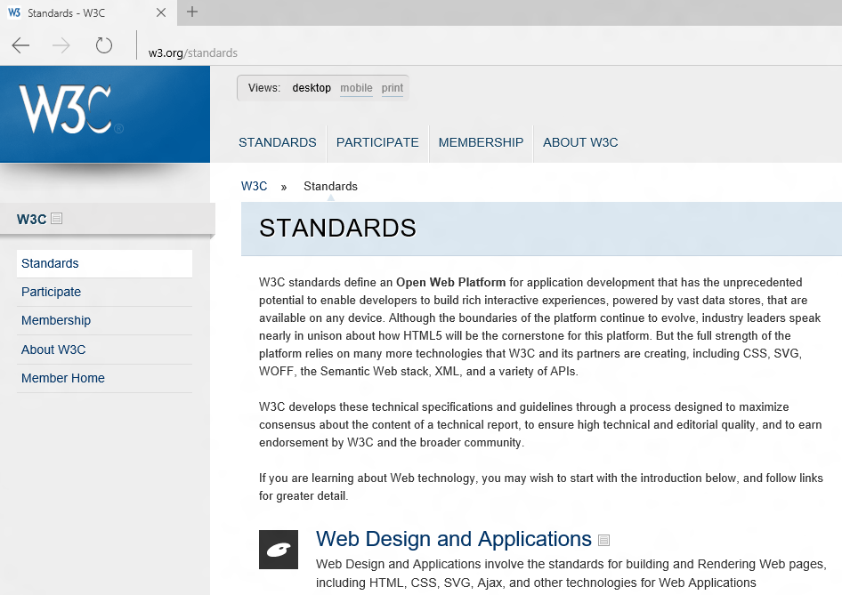
XAML WebView Enhancements
Spartan “Edge” in Windows 10
WinRT Access
And More…
See “Hosted Web” Apps session for details

Slide 57
XAML Improvements in Visual Studio

Slide 58
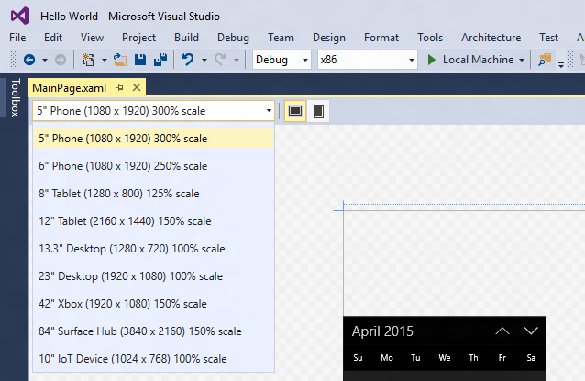
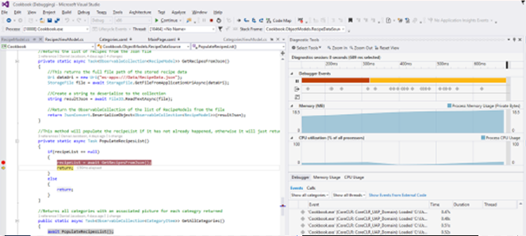
Visual Studio New design modes, performance instrumentation timeline tool and more…

Slide 59
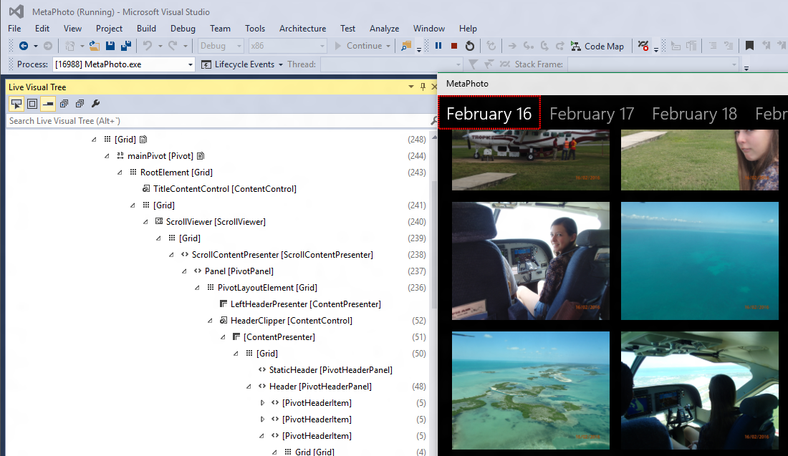
Visual Studio Visual Tree Inspector

Slide 60
And More…
CommandBar Updates
Vector Fonts
Property Change Improvements
New Content Presenter APIs
IME Composition Events
Directional Navigation
ListView Enhancements
Framework Element Loading Event
Improved Animation Experiences
Improved XAML/DX Interopability
Software Bitmap Source
Silverlight memory improvements
Printing APIs on Mobile
Improved BiDi handling
Improved ScrollViewer APIs
Casting in media elements

